Slide 1
Using and Creating Salesforce Reports

Slide 2
Reports Compared to List Views
List views are a quick way to view data
Single object (like Outreach Activity Forms)
“Flat” file, like an Excel spreadsheet, no grouping or summarization
Limited to 2,000 records
Reports can:
View data from multiple objects (like Outreach Activity Forms and their related sessions, Opportunities, and/or Event/Classes)
Group, summarize/rollup, and calculate
More flexible filtering
Export to Excel (and include more than 2,000 records)
Schedule to run automatically with results sent via email

Slide 3
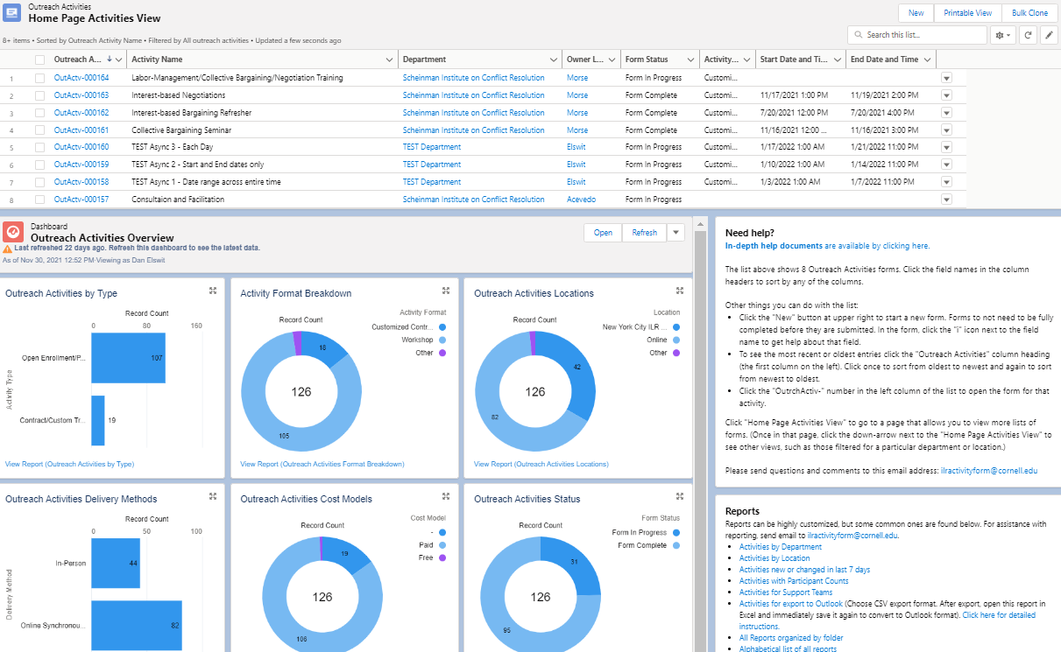
Reports
A quick way to get to reports is to click the report links on the Home Page at the lower right:

Slide 4
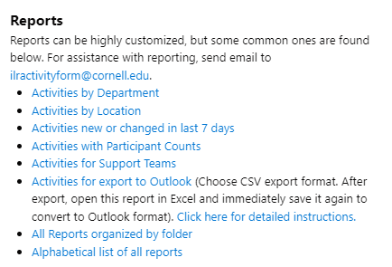
Let’s Look at a Report

Slide 5
Viewing a Report
2
1
3
5
4
Report Title
Filter the report
Total records in the report
Groupings, departments in this case (not all reports have groupings)
Number of records in this grouping, per department in this case

Slide 6
Begin Filtering
To start filtering in either a list view or a report, click the filter icon and then select your desired filter values in the right-hand column:

Slide 7
Filtering In-Depth
There are many thousands of records in Salesforce
Think ahead of time about what you wish to appear in the output
You may want to have a record open to see the available fields
It’s especially helpful to think about how to group the data
For instance (these can also be combined for more complex filters):
Group by Department
Group by Location
Group by Instructor
Group by type of activity
Group by delivery method of activity
Group by Responsible Director
Group by Status

Slide 8
Filtering Operators
Filters can use many operators:
Equals
Not Equals
Greater than
Greater than or equal to
Less than
Less than or equal to
Contains
Does not contain
Starts with
For text, sometimes “Contains” is a better choice than “Equals”
Example: a filter where “Department Contains Scheinman” will return any record that includes the text “Scheinman” regardless of whether “Institute” or other text is in the name

Slide 9
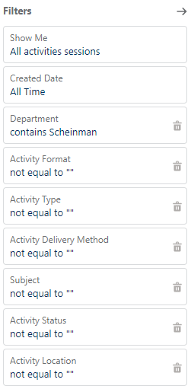
Filtering Example
Filters look the same regardless of whether they are for list views or reports
To the right is the example from the previous slide, where the department contains the word “Scheinman”
Remember to use “contains” instead of “equals” unless you are looking for an exact match
To look for multiple values, use a comma, as in “Webinar,Workshop”

Slide 10
Filtering Tips
Have an Outreach Activity Form open in another tab or window so that you can see the available field names
For text fields, if there is any ambiguity, use “Contains” rather than “Equals”
Date ranges work as expected (Equal or greater than 9/1/2021 and less than or equal to 9/30/2021 yields all of September of 2021)
Use Ctrl-Click to select multiple picklist values
Use a comma to separate other types of multiple values

Slide 11
Finding Other Reports
At the bottom of this list of reports are two links that go into the full reporting system where there are over 500 reports and a report generator
All reports organized in folders
All reports as an alphabetical list
1
2

Slide 12
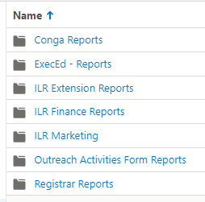
Find Reports by Folder Organization
Your job role will determine what folders you see
Commonly, people see the following folders:
Click here to see all available Outreach Activities reports.

Slide 13
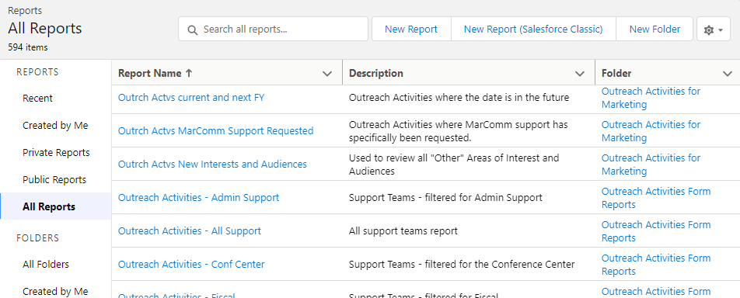
Find Reports by Searching
There are over 500 reports at present
To search all available reports:
Click “All Reports” in left column
Use the search box to find reports
Click on a report name to view it

Slide 14
Know the Objects (Tables)
Remember that there are multiple objects that make up an Activity Form
Activity Form
Activity Sessions
Opportunity
Event/Class

Slide 15
Relationships Between Data
One record may have many related “child” records
Activity Sessions work this way
Outreach Form “Intro to Climate Change”
Activity Session1 – 5/1/2022 9:00 am to 5/1/2022 4:00 pm
Activity Session2 – 5/2/2022 9:00 am to 5/2/2022 3:30 pm
One record has exactly one related record as a peer
Opportunities and EventClasses work this way
Activity Form “Intro to Climate Change” ----→ Related Opportunity amount
Activity Form “Intro to Climate Change” ----→ Related EventClass participant count

Slide 16
Creating a Report Step-by-Step
Select a “report type”
Add fields you wish to appear in the report
Reorder fields as needed
Optionally add filtering
Optionally add grouping
Save
Test

Slide 17
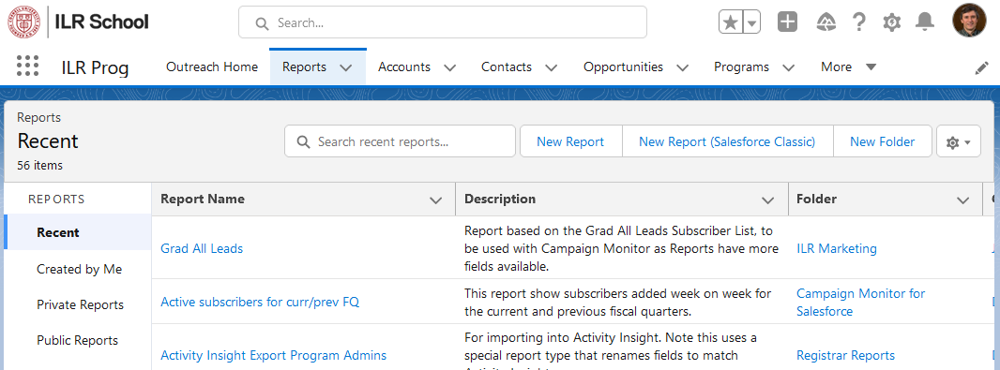
Creating New Reports
To start creating a new report, click the “Reports” tab, then click the “New Report” button:

Slide 18
Report Types
Report types are created by system administrators
Report types define relationships between related tables of data
Nomenclature: “with or without”: includes records regardless of whether they have related records
You will mainly be concerned with 4 report types
Outreach Activities
Outreach Activities with or without Sessions
Outreach Activities with or without Opportunities
Outreach Activities with or without EventClasses

Slide 19
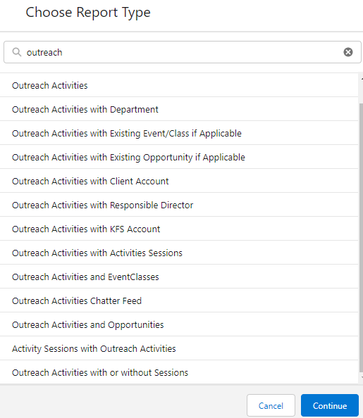
Choose a Report Type
On the Report Type screen, type “outreach” in the search bar at the top to filter
Choose the desired report type
Click Continue

Slide 20
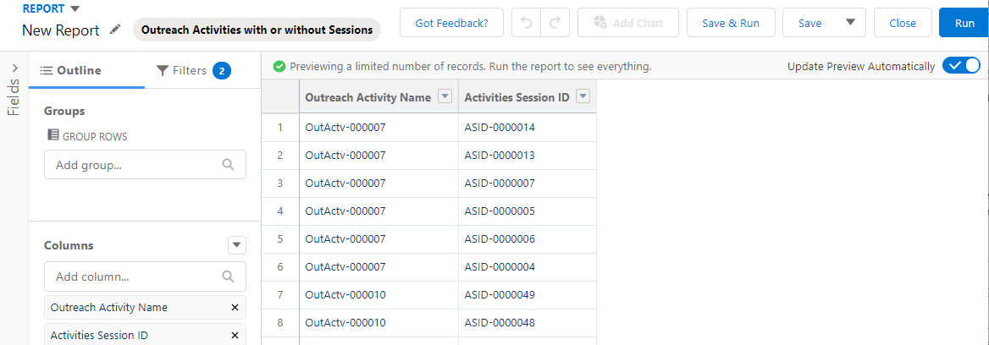
Report Builder
5
4
2
3
1
Add fields here, click in the blank and being typing the name of the desired field
Group by fields here
Your report will appear here as you add fields
Filter your report by clicking here
Save or save and run by clicking here

Slide 21
Turn on Update Preview Automatically
This will cause changes to the report to appear immediately in the report builder. For very complex reports it may be desirable to turn this off, but generally you will likely want it on.

Slide 22
Filtering Reports
3
1
2
Major “gotcha”! By default all new reports are filtered for ONLY items you own!
Change the “Show Me” filter to “All Activities”
Select the desired Created Date (or Start Date) range
Add other filters as desired using the Add filter blank

Slide 23
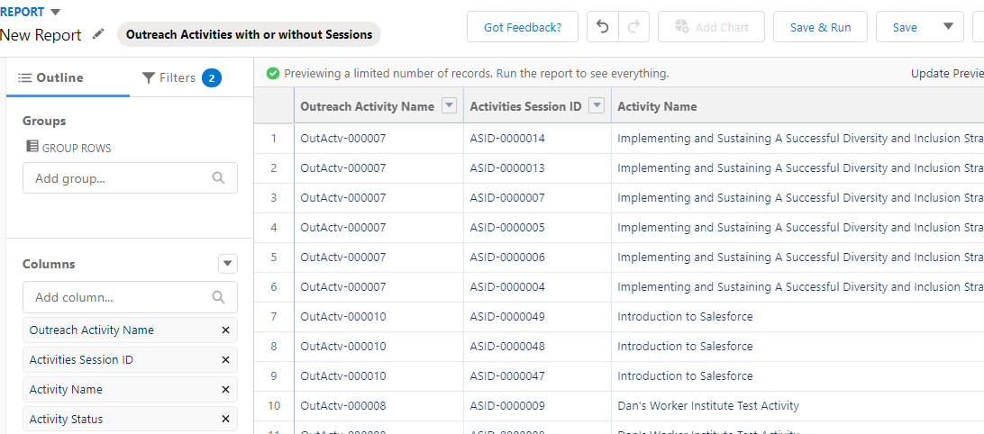
Adding Fields to a Report, Method 1
1
If you know at least part of a field name, type that into the “Add column” blank to find the desired field. Scroll to see more fields.

Slide 24
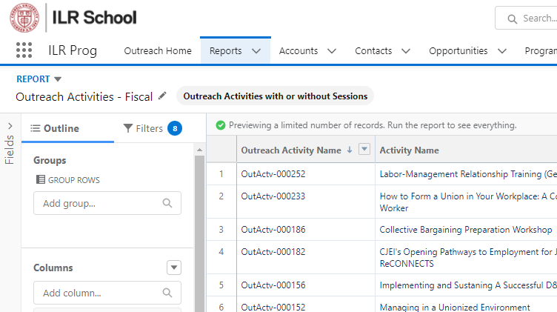
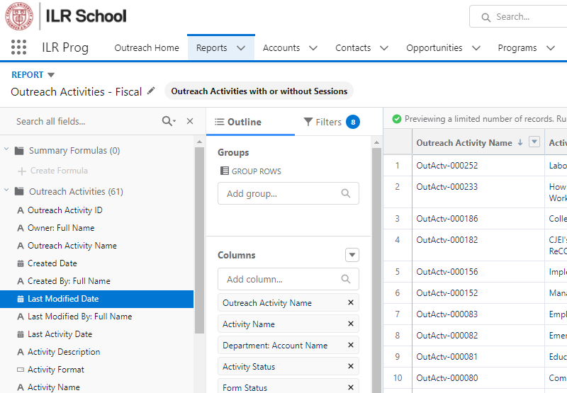
Adding Fields to a Report, Method 2
If you want to see all the fields for all the objects at once, click the “Fields link to the left, locate the desired field, and drag into the builder pane to the right.

Slide 25
Tips for Adding Fields
Fields are arranged both in the scrolling list and the Fields list in alphabetical order, grouped by object.
Activity Form fields will always be at the top of the list
Activity Session fields, if included, will always be next (some fields are duplicated between the form and its child sessions)
Opportunity or EventClass, if included, will come last
The data in the builder is just a sample and does not include all data. To see all data, run the report, but remember that it hasn’t yet been saved!

Slide 26
Why are fields duplicated?
A small subset of fields appear in BOTH the Activity Form and the Activity Sessions.
The fields on the Activity Sessions are simply echoing the data in the parent form and are not editable.
Two reasons they exist:
It’s convenient for users to see some form data right on the session.
The calendar does not understand the relationships between the objects, so to get around that, we mirror some data from the parent onto the child records so that it’s available in the calendar filters.

Slide 27
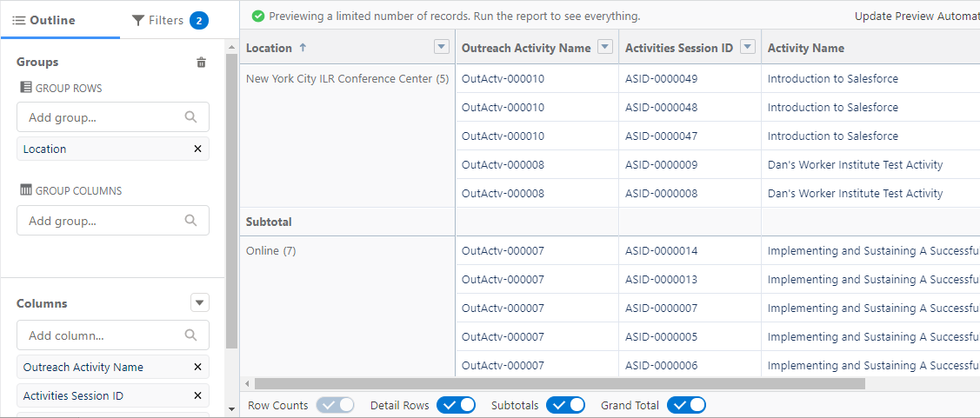
Grouping by Fields
1
2
Group by any field by selecting it in the “Group Rows” blank. For now, ignore “Group Columns”
If Subtotal and Total rows are unnecessary, remove them with the buttons at the bottom of the screen

Slide 28
Saving and Running a Report
1
2
3
Save the report and then immediately exit the Builder and run it
Save the report but do not exit the Builder
Run the report but do not save it (Caution! If you do not Edit the report and come back into the Builder and save it you will lose it)

Slide 29
An Advanced Demonstration
Creating a clickable summary chart of number of activity formats and participants per department
Use Outreach Activities report type
Add Activity Name and Number of Participants fields
Group by Department on rows
Group by Activity Format on columns
Run report
Note interaction between report summary at top and detail rows at bottom

